Slide 1
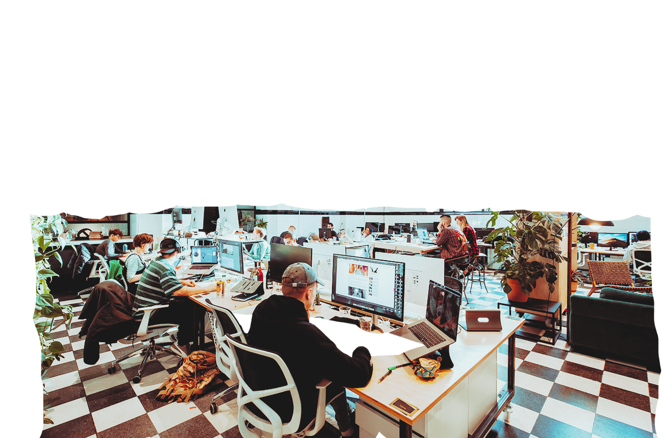
GROUP 2
ITS120L PRESENTATION
TASKTREK
ELEVATOR PITCH
SOURCE: THISWORK.SPACE

Slide 2

PROBLEM
Task distribution is a common occurrence within the home and group environments, but they often create conflict, which causes tension in group settings. We need a more effective, motivating, and modern solution to delegating tasks among groups. This can help improve productivity, structure and centralize task distribution, which in turn improves relationships and connection.
COUPLE HAVING AN ARGUMENT | CREDIT: DEAN DROBOT VIA CANVA EDUCATION
“TURNING BORING, MUNDANE, OR UNPLEASANT TASKS INTO MOTIVATING AND EXCITING GOALS IN THE GAME CAN REDUCE TASK AVERSIVENESS – AN IDENTIFIED PROCRASTINATION FACTOR”- ORTON SAID. SOURCE:
“THAT'S YOUR JOB, we talked about this!”
“There's SO MUCH I have to do”
Main Points:
Uneven tasks cause frequent conflict.
Old methods lack lasting motivation.
Social groups need fair modern solutions.
“These tasks are SO DRAINING”
Problem Statement:
"How can we leverage emerging technologies to enhance task delegation and management while promoting effectivity, organization, and fairness?”
BY JUSTIN VITO | DARWIN CANTOS | LENARD ESCOBAR | CHERYLL KIWANG

Slide 3
APPROACH
SOLUTION STATEMENT
To address these challenges, we introduce , a mobile app designed to gamify task management. TASKTREK transforms routine responsibilities into engaging challenges by integrating features such as point systems, rotating assignments, badges, achievements, and leaderboards. It also includes an in-app reward shop managed by a group leader, where members can redeem points for customizable incentives. Designed with human-computer interaction (HCI) principles, the app ensures clarity, ease of use, and consistent motivation.
TASKTREK
TASKTREK
TRANSFORMING ORDINARY RESPONISBILITIES INTO INTERACTIVE CHALLENGES
A collaborative platform to gamify task management, and promote & sustain an effective, organized, and fair experience for all.
FEATURES:
GAMIFIEd Task Management – transforms routine responsibilities into engaging challenges.
Point System – earn points for completing tasks.
Rotating Assignments – fairly distribute responsibilities among members.
Badges & Achievements – recognize milestones and progress.
Leaderboards – encourage healthy competition and motivation.
In-App Reward Shop – managed by a group leader, where members can redeem points for customizable incentives.
HCI-Driven Design – ensures clarity, ease of use, and consistent motivation
AI FEATURE:
Our to-do list application TaskTrek will feature an AI-assisted task suggestion tool.
The AI will analyze past entries, repetitions, and keywords from the user’s tasks.
Based on repetitive behavior, it will propose appropriate activities at the right time.
This helps users save time and energy in organizing their schedules.
It promotes consistency and productivity across various aspects of their daily routines.

Slide 4



BENEFITS
Stronger Collaboration
pPomotes teamwork by turning tasks into shared challenges instead of obligations.
Fair Task Distribution
Ensures tasks are rotated or assigned evenly among members, reducing conflict.
Increased Motivation
Gamification features like points, badges, and leaderboards encourage consistent participation.
Conflict Reduction
Minimizes misunderstandings or passive-aggressive reminders by providing a fair, automated system.
Improved Organization
Tasks are tracked, categorized, and monitored in one platform, preventing forgotten or duplicated responsibilities.
Scalability Across Groups
Usable not just in households, but also in dorms, student groups, and small teams.
User-Friendly Design
Built with HCI principles for clarity, ease of use, and accessibility.
Enhanced Accountability
Transparent progress tracking shows who completed what and when and what’s currently being done.
VICO SOTTO LGU VENDOR ROLLOUT, REDDIT (U/PMA1919)
EXISTING SIMILAR USE CASE BENEFITS:
In their 2022 study, Hosseini et al. found that “gamification has increased the quality of work in task performance”. Moreover, gamification has improved deliveries -- where a deadline is missed, users always managed to deliver. TaskTrek builds on this by providing a digital platform that manifests this approach into reality, using tech to inject point systems, rotating assignments, badges, achievements, and leaderboards in task management.
Notes:
Fair Task Distribution – ensures tasks are rotated or assigned evenly among members, reducing conflict.
Increased Motivation – gamification features like points, badges, and leaderboards encourage consistent participation.
Improved Organization – Tasks are tracked, categorized, and monitored in one platform, preventing forgotten or duplicated responsibilities.
Enhanced Accountability – transparent progress tracking shows who completed what and when.
Stronger Collaboration – promotes teamwork by turning tasks into shared challenges instead of obligations.
Customizable Rewards – members stay engaged through an in-app reward system managed by a leader.
User-Friendly Design – built with HCI principles for clarity, ease of use, and accessibility.
Conflict Reduction – minimizes misunderstandings or passive-aggressive reminders by providing a fair, automated system.
Scalability Across Groups – usable not just in households, but also in dorms, student groups, and small teams.
Security & Trust – with features like two-step verification (for TaskTrek), user data and group integrity are protected.

Slide 5
COMPETITION
DIFFERENCE FROM TASKTREK
HABITICA - gamifies personal habits but focuses on individual self-improvement. TaskTrek centers on shared group tasks, ensuring fairness and accountability among members.
Google Keep - is a simple note-taking and reminder tool. TaskTrek adds structured task rotation, rewards, and gamification.
Todoist - organizes tasks efficiently but emphasizes personal productivity. TaskTrek goes further by embedding game mechanics and group incentives, strengthening teamwork and reducing conflict.
THREE
DIRECT
CURRENTLY THERE ARE
COMPETITORS IN THE PH MARKET FOR A STREET VENDOR CENTERED APP
DIRECT COMPETITORS ARE:
HABITICA
GOOGLE KEEP
TODOIST

